Slide 1
PORTFOLIO WEBSITE
Presented By : Rahul Nagpure
Guided By :
Prof. Dr. Marathe Ashutosh

Slide 2
TABLE OF CONTENTS
01
02
03
04
INTRODUCTION
WHY YOU NEED PORTFOLIO WEBSITE
OBJECTIVES
LITERATURE SURVEY
05
06
BLOCK DIAGRAM
PROJECT TIMELINE

Slide 3
01
INTRODUCTION

Slide 4
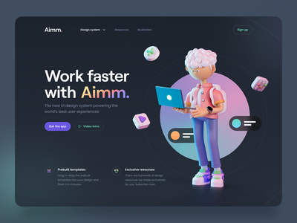
PORTFOLIO WEBSITE
COMPANY LOGO
Your tagline here
A portfolio website is a unique way to showcase your work and let others know about yourself.
It’s like an evergreen platform for your projects, case studies, and information about you. In addition, it’s one of the best ways to express your personality, experience, and capabilities.

Slide 5
02
WHY YOU NEED PORTFOLIO WEBSITE

Slide 6
WHY YOU NEED PORTFOLIO WEBSITE
In a nutshell, you need a portfolio website to showcase your work. Whether you’re an individual, a small team of two or a company of ten people, it’s crucial that you have a unique online approach. A website portfolio will help you stand out from the crowd, show your uniqueness, build trust, and make sure that others can actually find you.

Slide 7
03
OBJECTIVES

Slide 8
OBJECTIVES
ABOUT
1
2
CAREER
CONTACT
3
4
UI/UX
Develop an attractive and user friendly User Interface
Brief Introduction, Skills, and other necessary details
Education Details, Projects completed, Client Reviews, etc.
Contact details such as Social media handles, email, number

Slide 9
04
LITERATURE SURVEY

Slide 10
LITERATURE SURVEY
A Personal Web Portfolio: Creating an Online Presence from Conception to Implementation
Why Do You Need a Portfolio Website and How to Create it?
Thesis By Marvin Pierre
The Anatomy of a Perfect Portfolio Website to Showcase Your Work
Blog by Alina Digital Marketing Specialist at Weblium
A Case Study of Personal Web Portfolio.
Case Study By Alexey Tsykunov
Blog by Linda Ragaine

Slide 11
05
BLOCK DIAGRAM

Slide 12
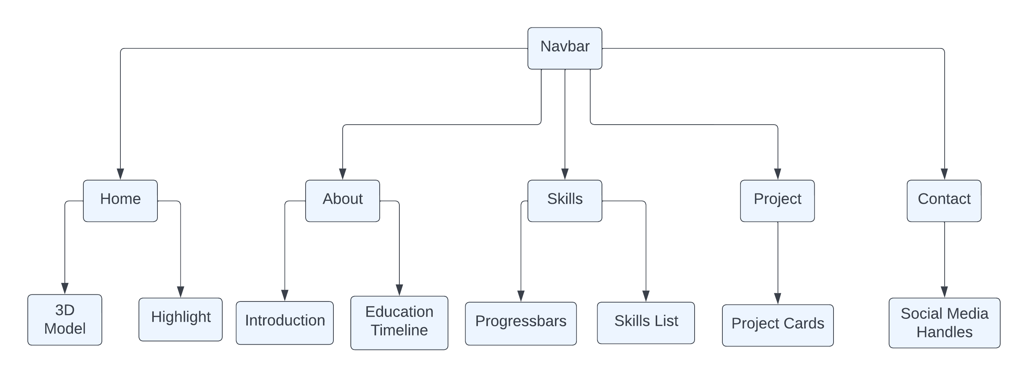
BLOCK DIAGRAM

Slide 13
06
Output

Slide 14
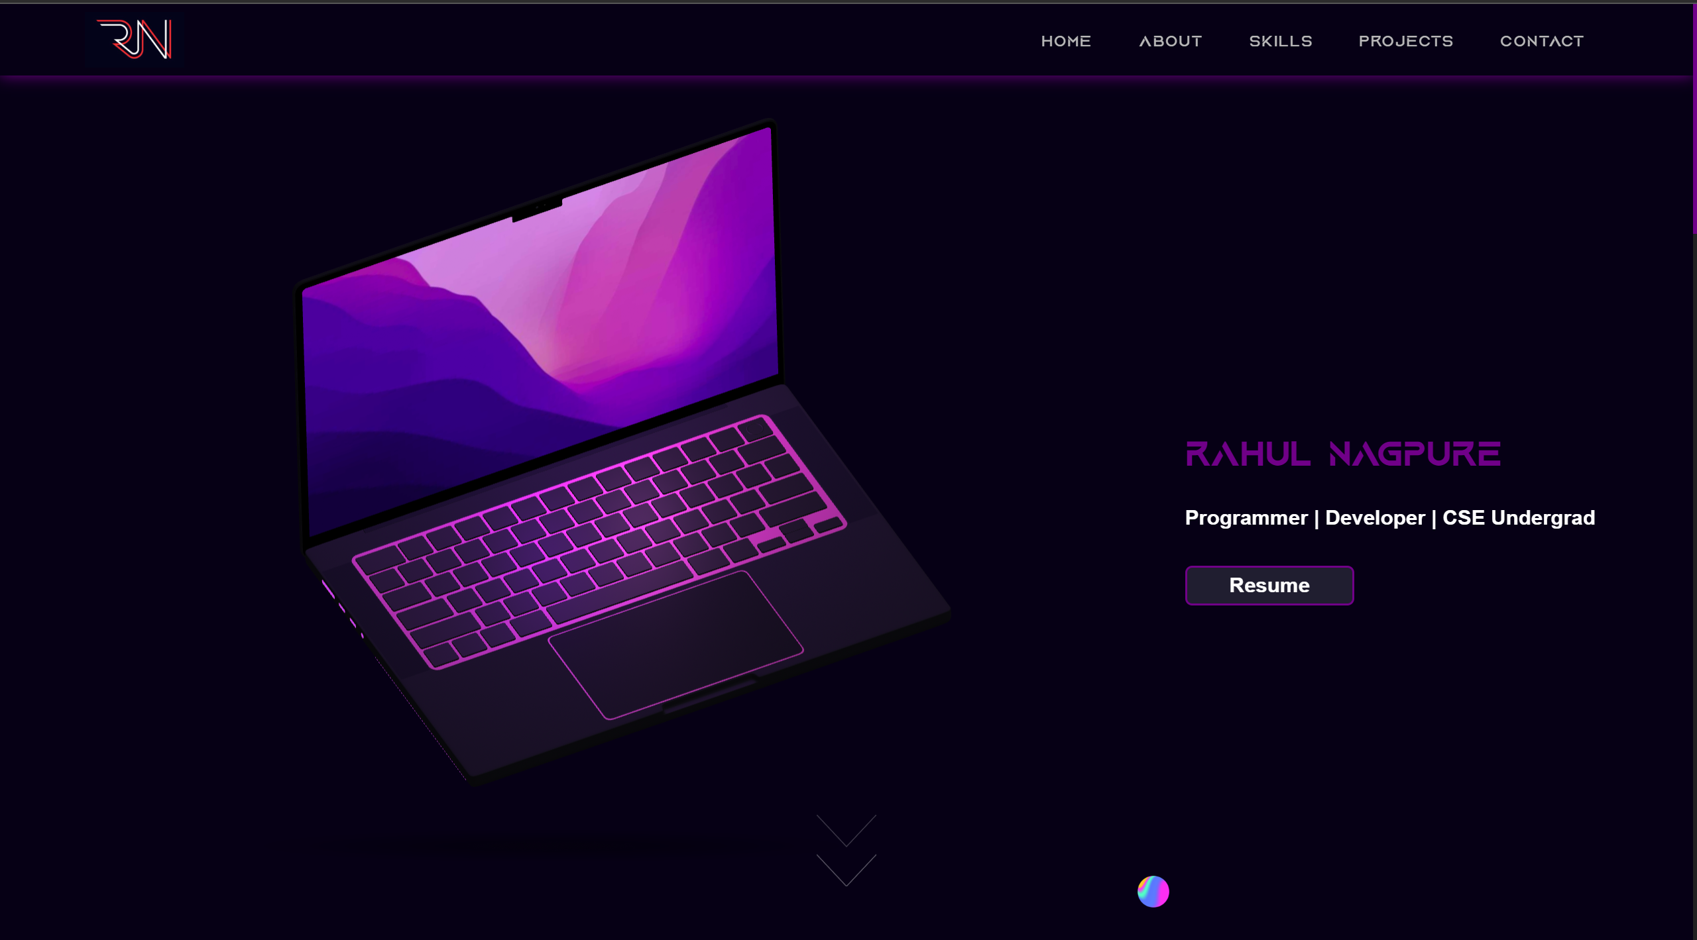
Homepage

Slide 15
07
REFERENCES

Slide 16
REFERENCES
https://www.theseus.fi/bitstream/handle/10024/112490/Thesis%20Work%20Alexey%20Tsykunov%20DE09.pdf?sequence=1&isAllowed=y
https://soar.suny.edu/bitstream/handle/20.500.12648/1669/Pierre_FINAL%20%281%29.docx%20ks.pdf?sequence=1&isAllowed=y
https://kinsta.com/blog/portfolio-website/
https://weblium.com/blog/why-do-you-need-a-portfolio-website-and-how-to-create-it/#:~:text=An%20online%20portfolio%20is%20certain,a%20master%20of%20the%20craft.
https://www.webfx.com/blog/web-design/portfolio-website-design-guide/

Slide 17
THANKS!
Do you have any questions?

Slide 18
06
PROJECT TIMELINE

Slide 19
PROJECT TIMELINE
25mar-10april
11april-17april
18April-10may
10may-15may
16may-20may
Research, Analysis and Requirements
Design
Development
Review and Testing
Deployment

